Slide 1


SE testing tools
By Awais Adnan
Mir Humayun Nisar
Asad Manzoor
Hurarah Bashir

Slide 2
ACUNETIX
Acunetix is an automated web application security testing tool that audits your web applications by checking for vulnerabilities like SQL Injection, Cross site scripting and other exploitable vulnerabilities. In general, Acunetix scans any website or web application that is accessible via a web browser and uses the HTTP/HTTPS protocol.
Acunetix offers a strong and unique solution for analyzing off-the-shelf and custom web applications including those utilizing JavaScript, AJAX and Web 2.0 web applications. Acunetix has an advanced crawler that can find almost any file. This is important since what is not found cannot be checked.

Slide 3

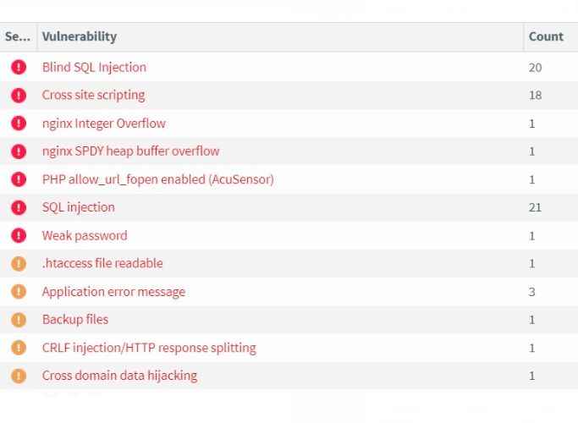

How Acunetix Works

Slide 4
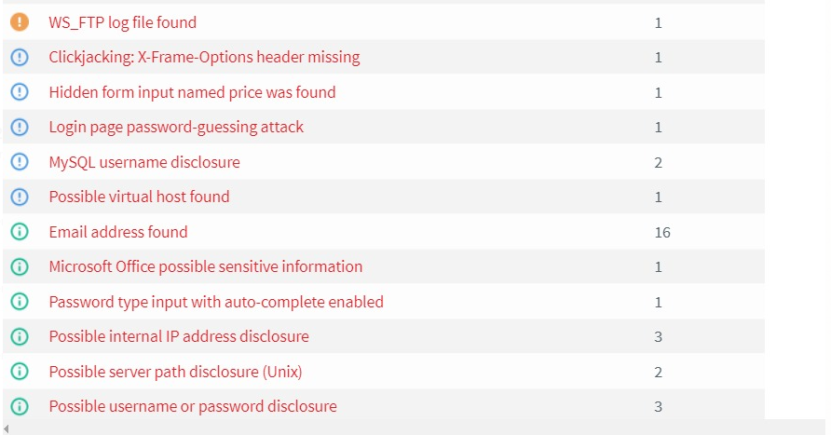
How Acunetix Works

Slide 5
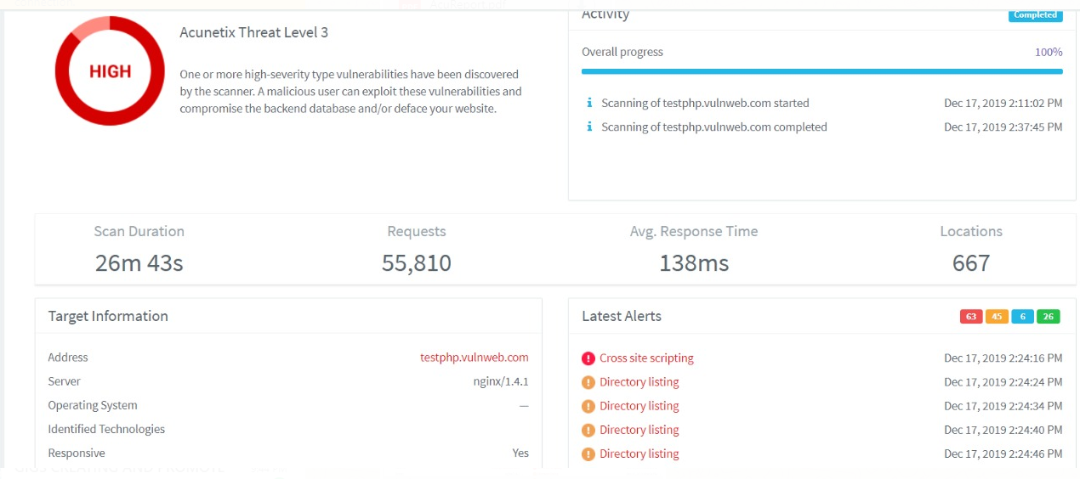
How Acunetix Works

Slide 6
LoadImpact
Load Impact is a leading online load and performance testing service that lets you test your website, web-app, mobile app or API locally or over the Internet. It’s a true on-demand service, where you can start testing immediately with our open source load testing tool, k6.
We provide cloud based load testing and automated results analysis as an online service to customers all over the world. In fact, our load-testing service is so popular that it’s already been used to execute over 1,500,000 load tests. Making Load Impact the most popular load testing service on the Internet.
Load Impact enables DevOps teams to deliver high performing websites, web apps and APIs to market faster and at lower cost.

Slide 7
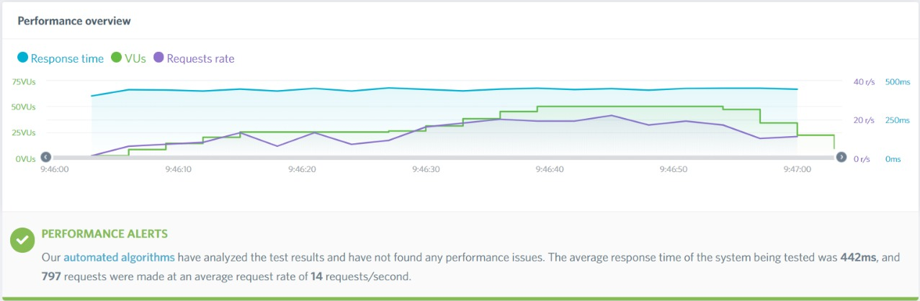
LoadImpact

Slide 8
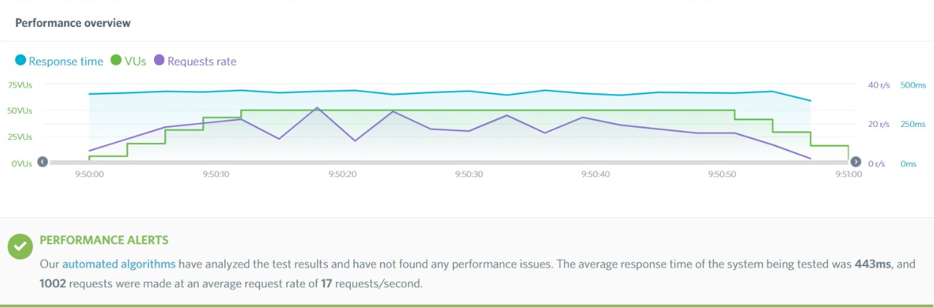
LoadImpact

Slide 9
JUnit Testing
JUnit is a Regression Testing Framework used by developers to implement unit testing in Java, and accelerate programming speed and increase the quality of code. JUnit Framework can be easily integrated with either of the following −
Eclipse
Ant
Maven

Slide 10
Features of JUnit Test Framework
JUnit test framework provides the following important features −
Fixtures
Test suites
Test runners
JUnit classes

Slide 11
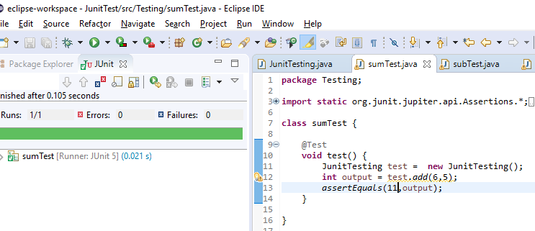
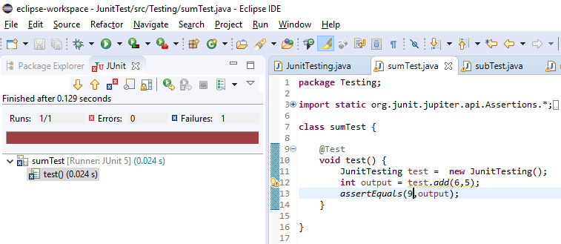
JUnit Testing - SumTest

Slide 12
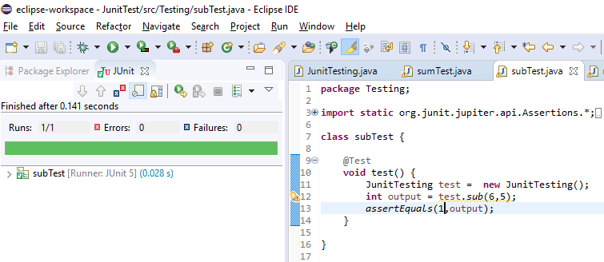
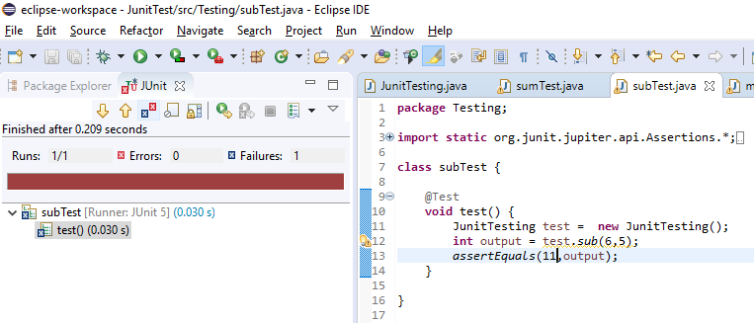
JUnit Testing - SubTest

Slide 13
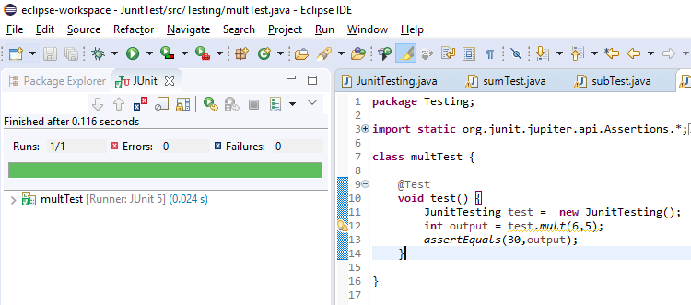
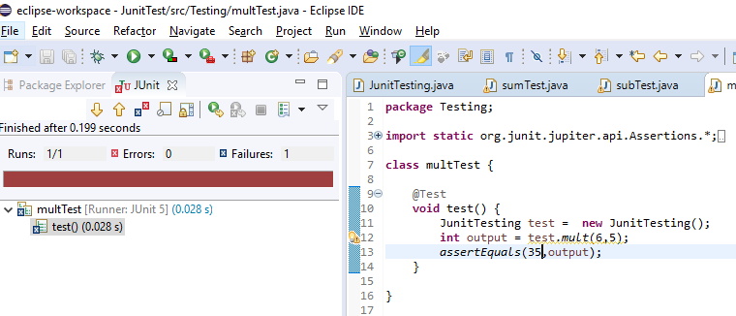
JUnit Testing - MultiTest

Slide 14
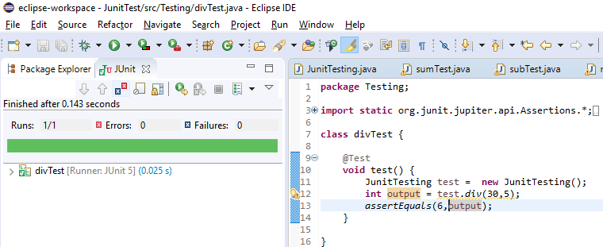
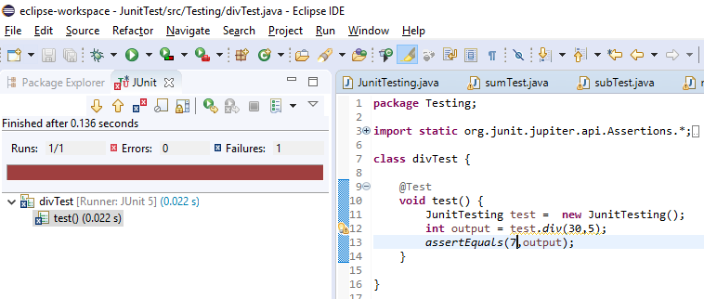
JUnit Testing - DivTest

